Slide 1


Expense Management System
Team Members:
Swayam Raj Singh
Koyena Brahma Amrutta Potta

Slide 2
Introduction
The Expense Management System is a software application designed to help users efficiently track and manage their financial expenses. By combining a robust backend with an interactive frontend, the system allows for secure data storage, categorization of expenses, and insightful analytics. It is aimed at simplifying personal or organizational financial management through an intuitive and streamlined user experience.

Slide 3
Features of This Project:
01
03
02
04
Track Expenses
Set Budgets
Keep a log of your daily spending
Create and monitor monthly budgets
Goal Settings
Reports
Save for specific goals with progress tracking
View detailed charts and reports of your spending habits

Slide 4
Tech Stacks:
Expense system
Backend
Springboot
Database
Frontend
React,JS
MongoDB

Slide 5

01
User Interfaces

Slide 6
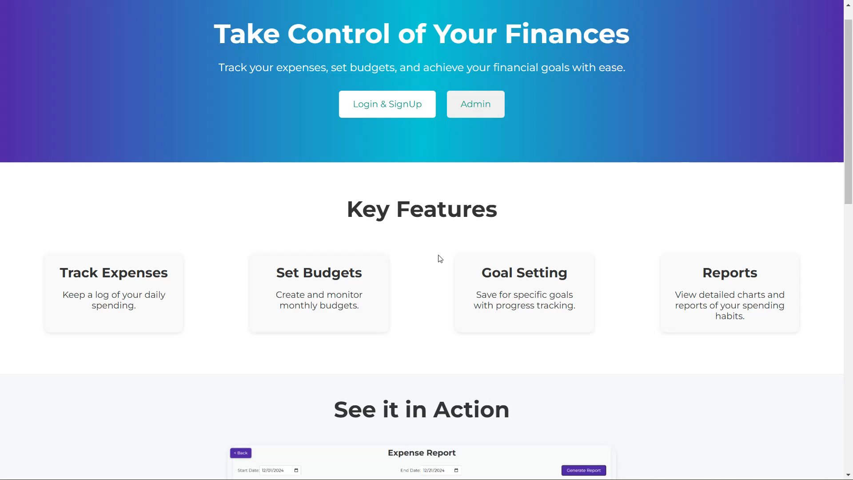
1. Home Page

Slide 7
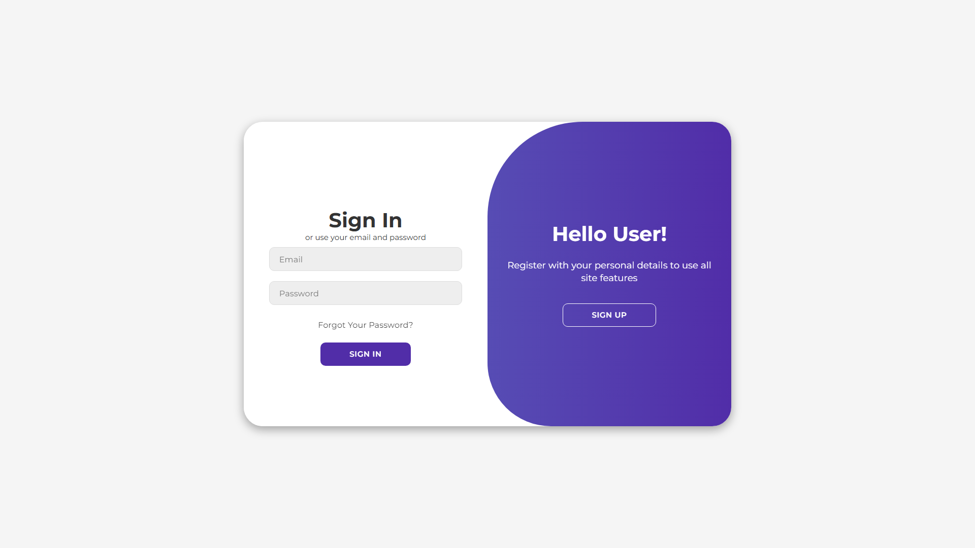
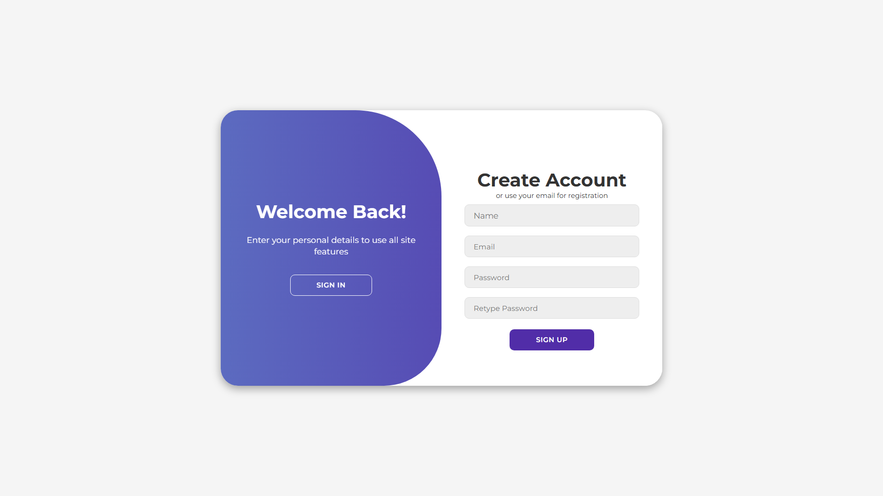
2. User Authentication

Slide 8
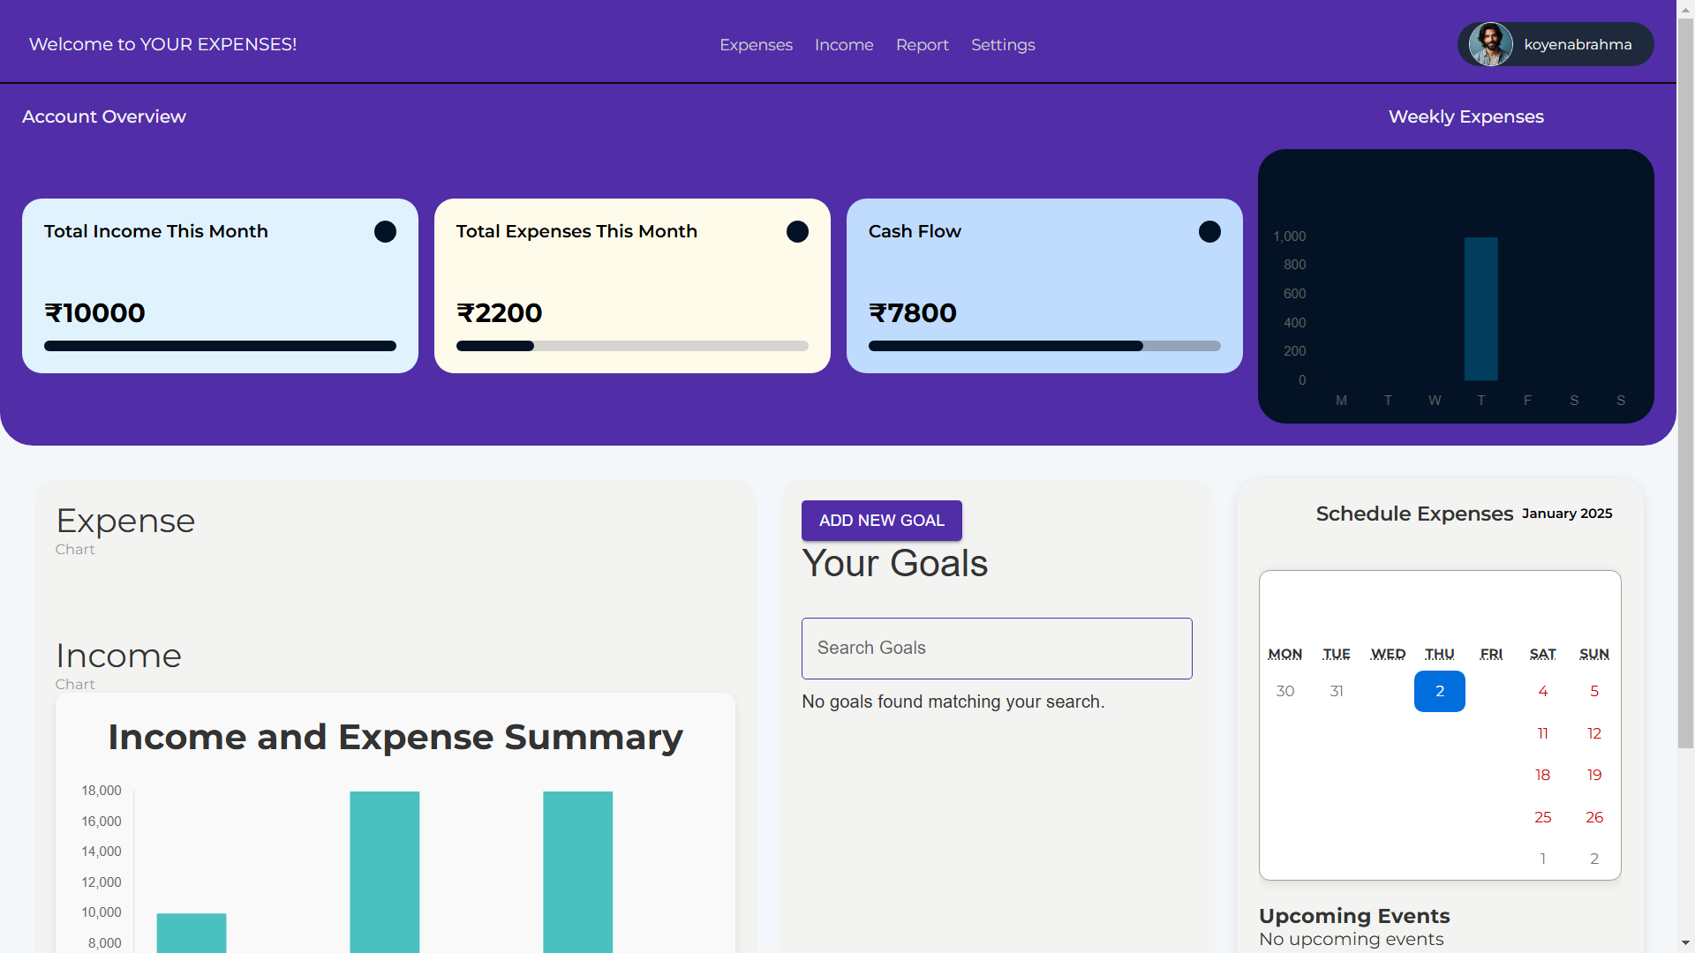
3. User Dashboard

Slide 9
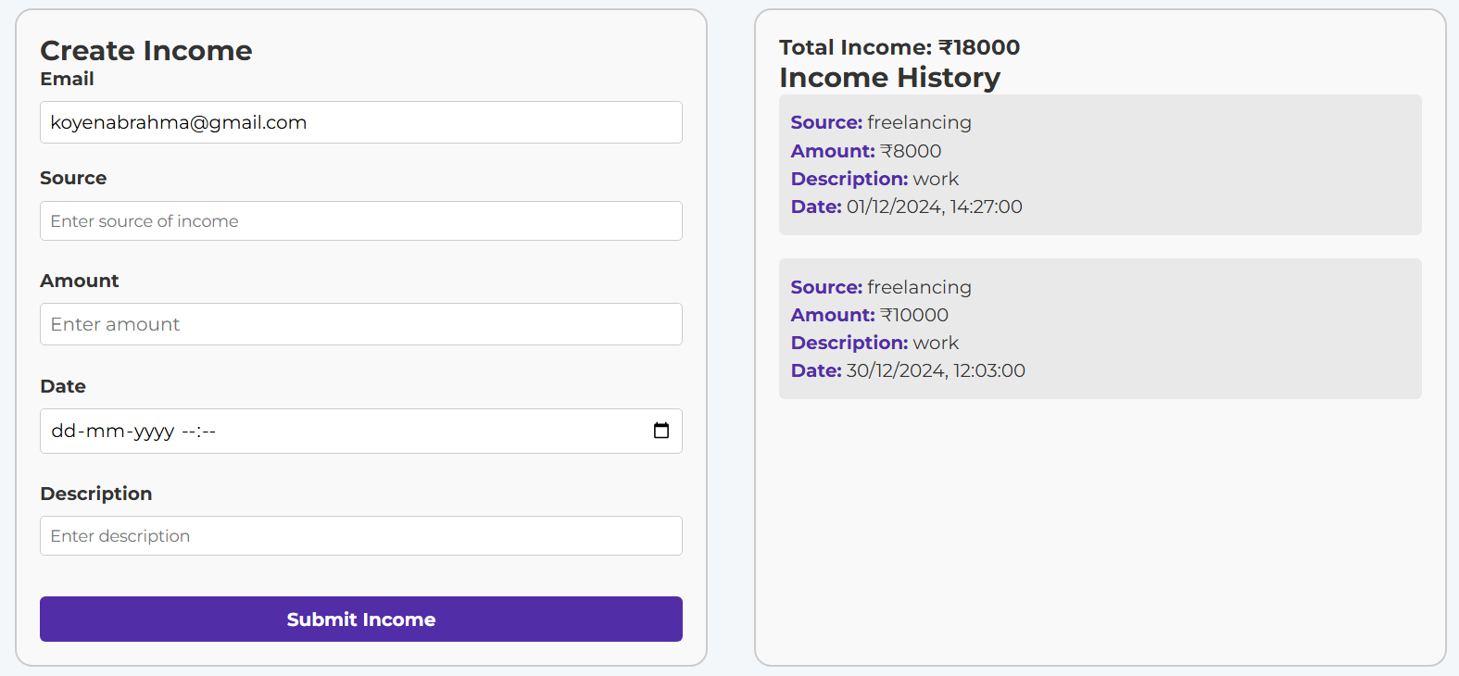
4. Add Income

Slide 10
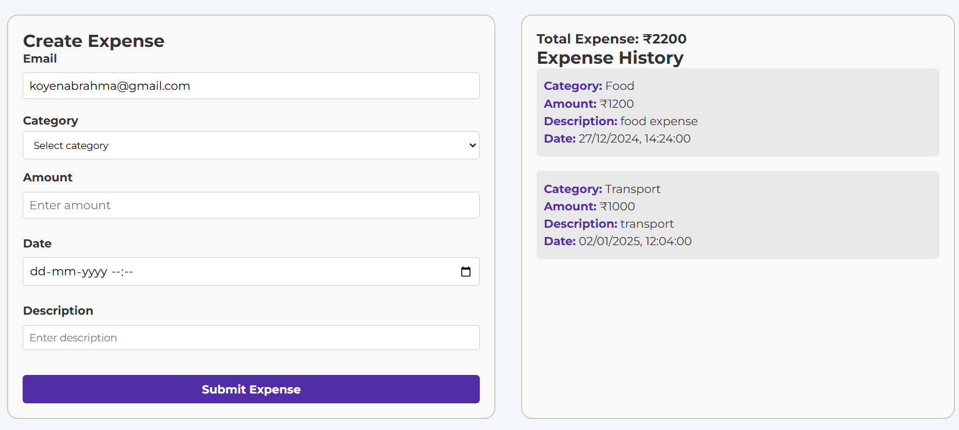
5. Add Expense

Slide 11
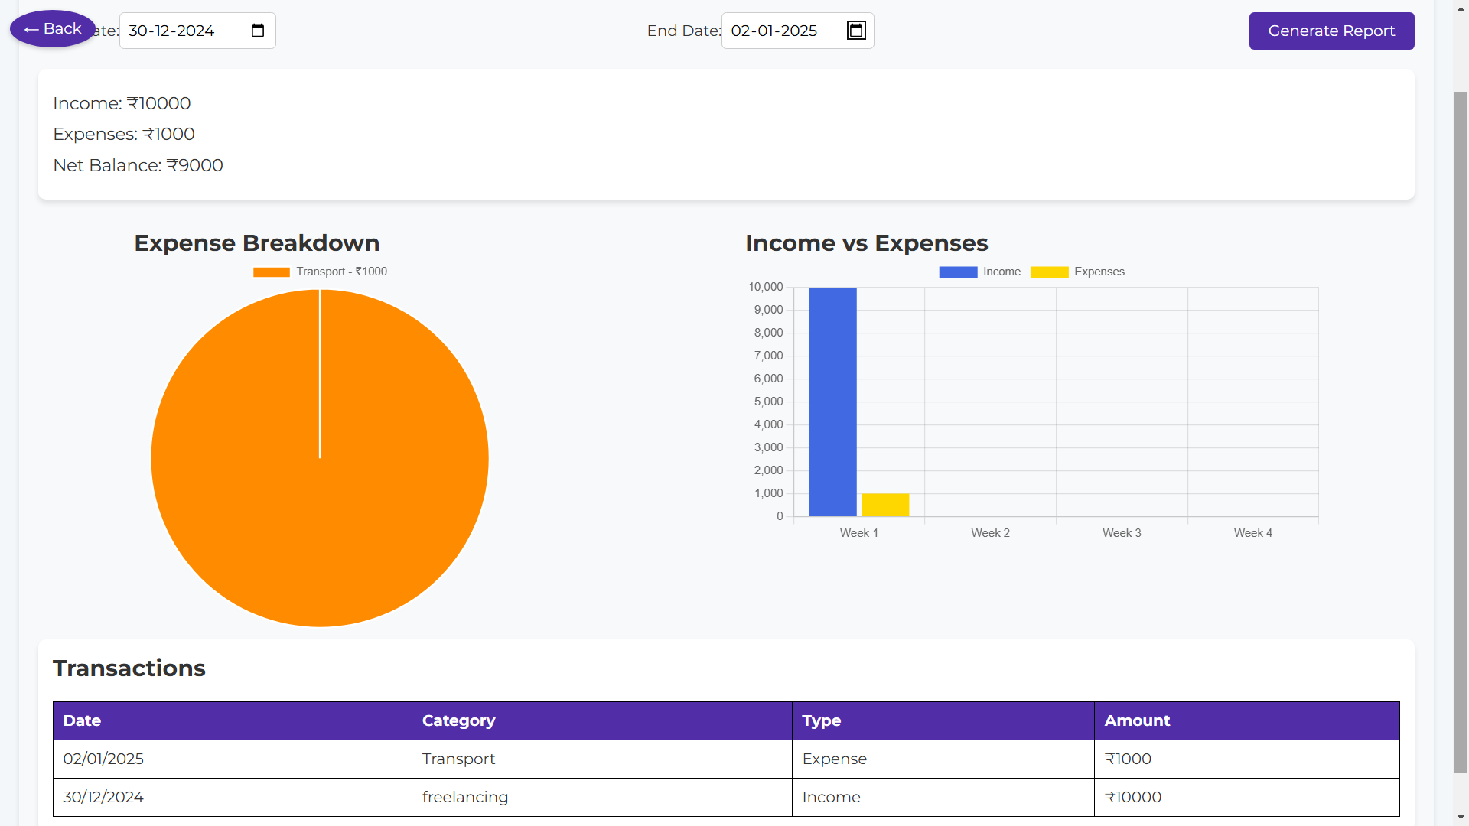
6. Report Analysis

Slide 12
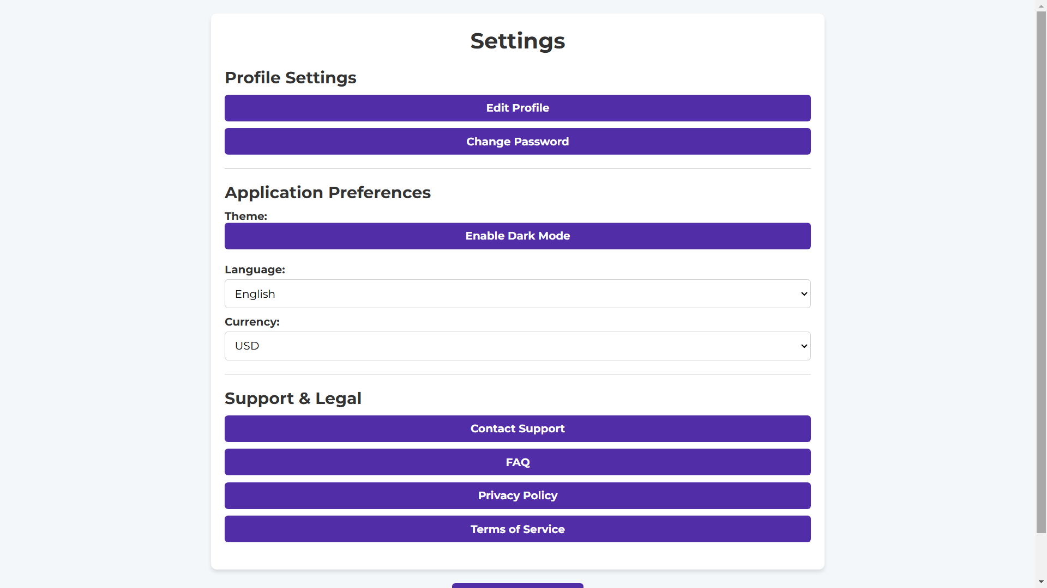
7. User Settings

Slide 13
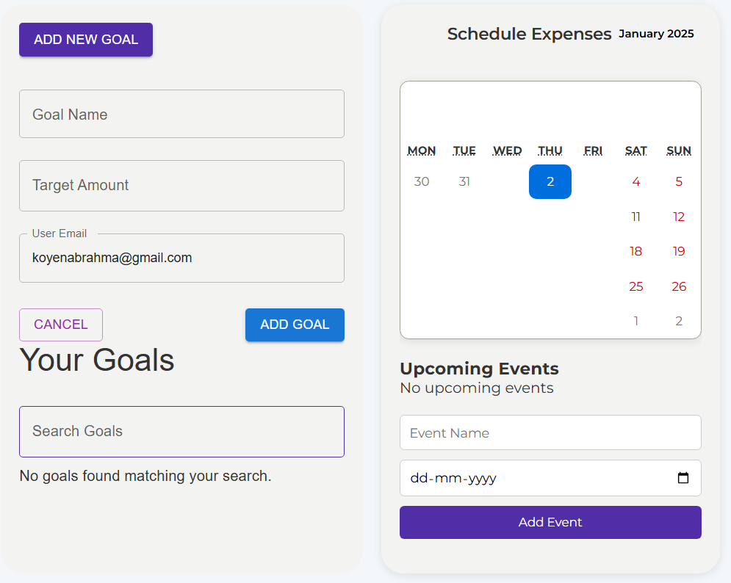
8. Add Goal & Schedule Expense

Slide 14
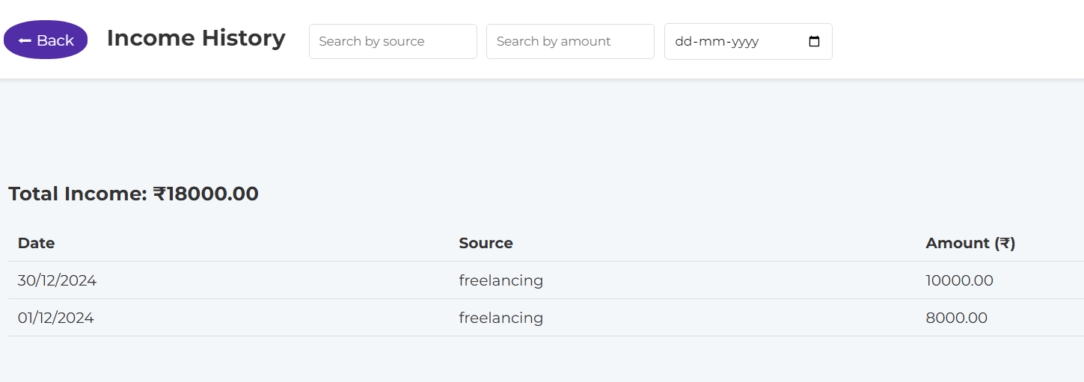
9. Income History

Slide 15
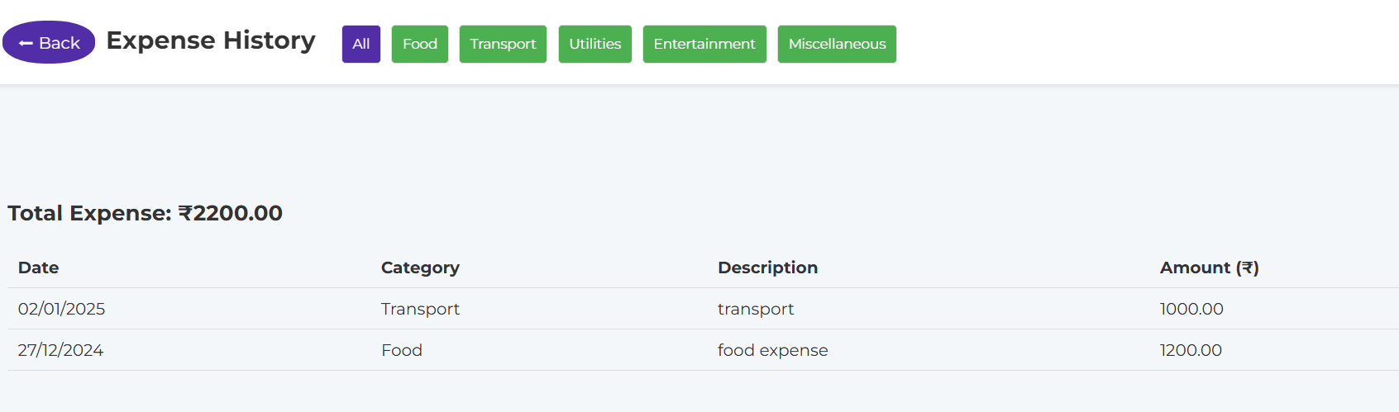
10. Expense History

Slide 16
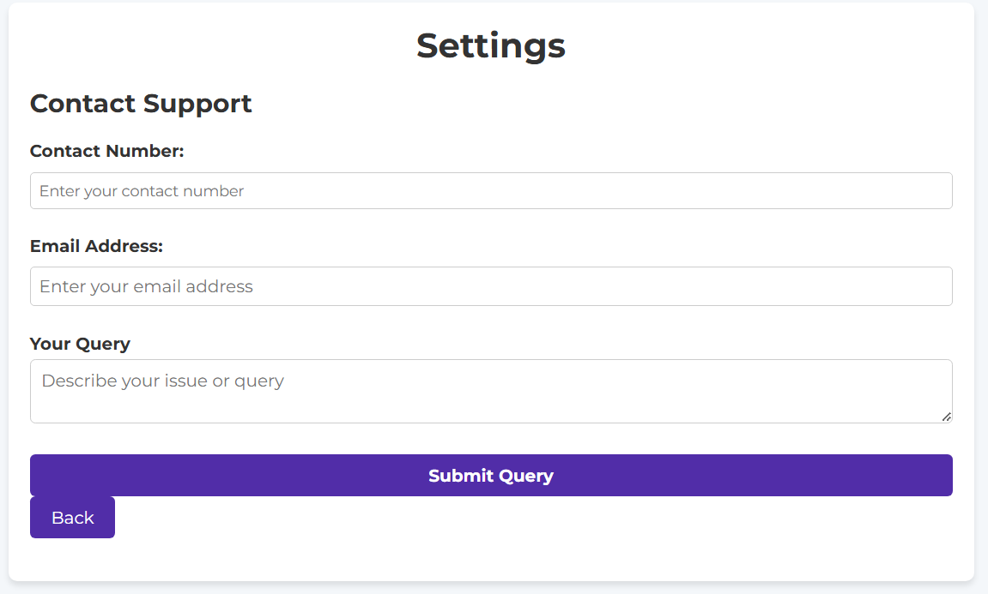
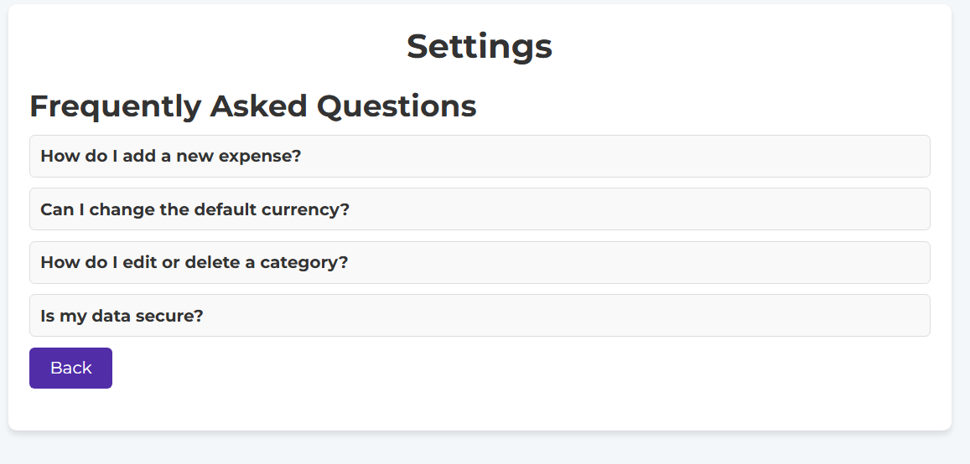
11. User Services

Slide 17
02
Admin Interfaces

Slide 18
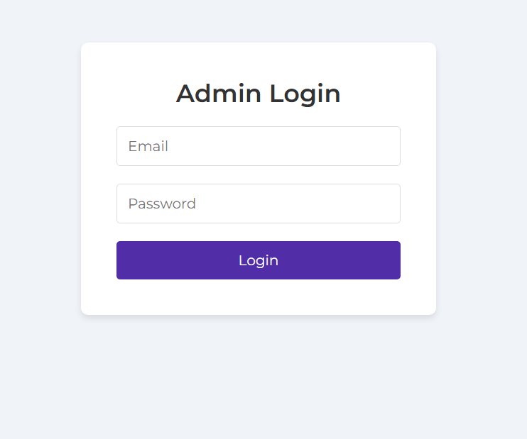
1. Admin Login

Slide 19
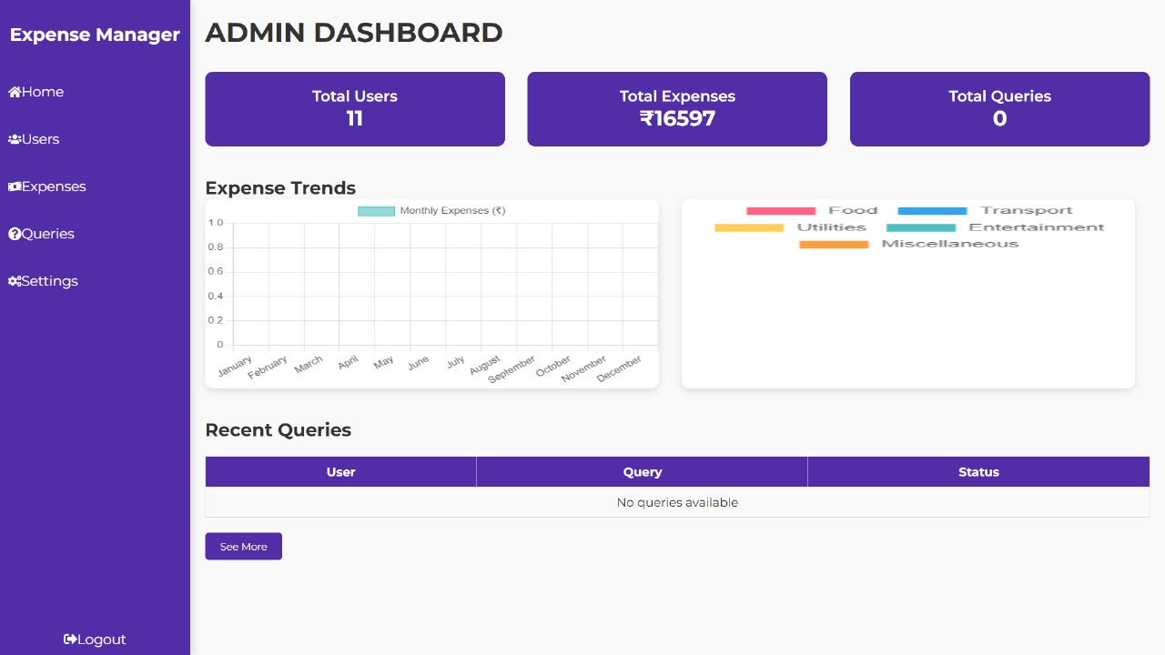
2. Admin Dashboard

Slide 20
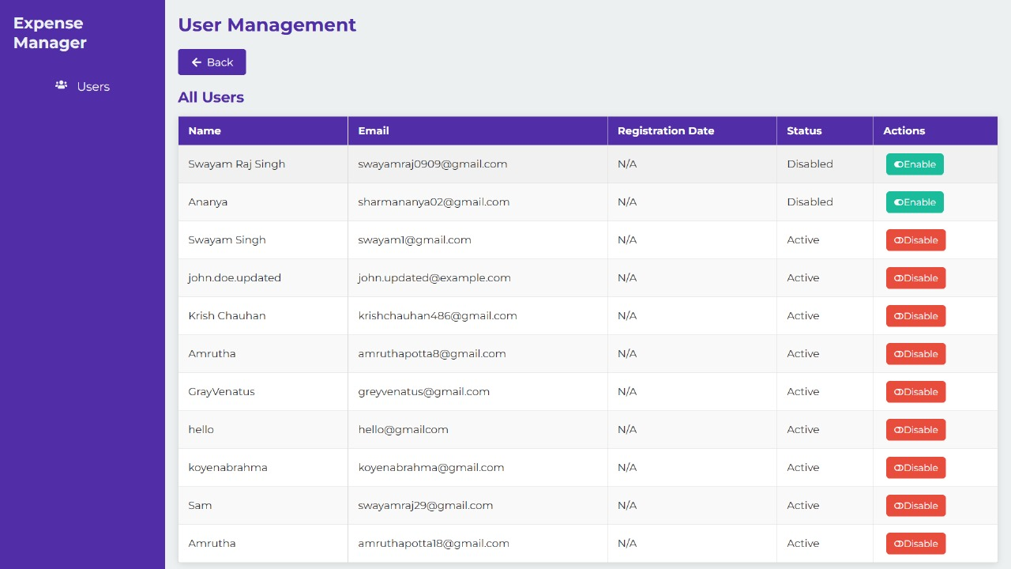
3. Admin - User Management

Slide 21
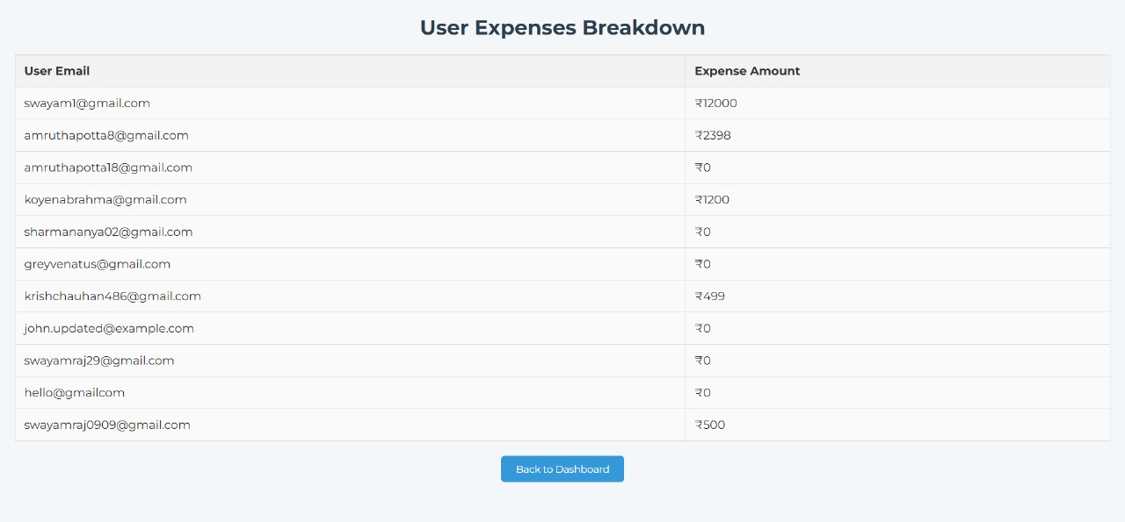
4. Admin - User Expenses Report

Slide 22
What sets us apart?
Customizable Features
User-centric Design
Comprehensive Expense Tracking

Slide 23
Conclusion
In conclusion, the Expense Management System stands out as a practical and innovative solution for managing financial records. With its blend of advanced technologies, user-friendly design, and secure framework, it offers a streamlined approach to tracking expenses and improving financial awareness. Its modular architecture and potential for scalability make it suitable for both personal use and organizational needs, empowering users to take control of their finances with confidence and ease.

Slide 24
Thank You!

